Slide 1
Hypothesis
It's been almost 5 years since the CAMS systems were spec'd
The latest models of low cost security cameras based on 1/3" sensors might now be sensitive enough to perform for CAMS
Given the smaller sensor, full-sky coverage may be obtained by using different focal length lenses depending on elevation angle
Is the resolution good enough for CAMS?
  Spatial resolution for accurate meteor surveillance at the target 4 arcmin/pixel or smaller
Is the FOV large enough to build an all-sky array using 16 cameras?

Slide 2
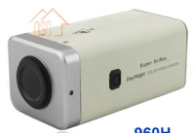

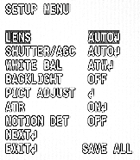
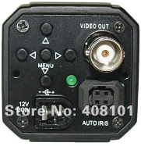
New 1/3" Cameras
Sony Super HAD II 960H based
Sony ExView HAD II 960H based
On-Screen Display (OSD) Menu
  Provides objective settings
$47 PSCB-100H
Sensor | 1/3" 960H High Sensitivity CCD
Resolution | 700 TVL
Minimum Illumination | 0.003 lux 30 IRE Normal shutter f/1.2/AGC
S/N Ratio | > 50 dB (AGC OFF)
Pixels | 976 x 494 NTSC (976 x 582 PAL)
Sensor | 1/3" 960H High Sensitivity CCD
Resolution | 700 TVL
Minimum Illumination | 0.003 lux 30 IRE Normal shutter f/1.2/AGC
S/N Ratio | > 50 dB (AGC OFF)
Pixels | 976 x 494 NTSC (976 x 582 PAL)
$56 LN-300-9H672
Care must be taken to get cameras based on the right sensor and matched with the right DSP firmware
Notes:
Ignore Sens-Up, WDR, ATC, etc.
1/3" Enhanced SONY EFFIO 700TVL High Resolution Security 0.0001LUX Box Cameras with OSD
$47 PSCB-100H
http://www.aliexpress.com/item/1-3-Enchanced-SONY-EFFIO-700TVL-High-Reoslution-Security-0-0001LUX-Box-Cameras-with-OSD/1570582896.html
Be sure to order without the IR cut filter
$56 LN-300-9H673
http://www.aliexpress.com/item/Free-shipping-1-3-SONY-960H-EXview-HAD-CCD-II-700TVL-0-0003Lux-Mini-D-WDR/577803305.html
IRE level
Maximum amplitude of video output from a CCD camera normally should be set at 100 IRE or 700mV. A video in 100 IRE means that it will fully drive a monitor to expressed best image with best brightness and contrast. a video with 50IRE means it has only half of the contrast. and 30 IRE mean 30% of original amplitude or 210mV. It is generally acceptable that 30 IRE is a minimum value for a meaningful image. A regular camera will have noise level on 10 IRE while AGC kicks up to max gain, hence will provide 3:1 or 10dB S/N ratio for a barley acceptable image.
A reading measured under 10 IRE will be 10 times better than under 100 IRE. So a reading without defining IRE level is actually useless.
We also tested the EQ700 camera. This is a higher end camera that has many features and is highly configurable. The IR cut filter has a motor that moves the filter out of the way for dark operation. It's about $120 from B&H.

Slide 3
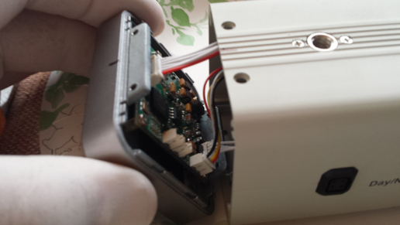
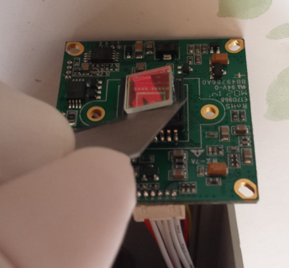
Remove the IR-cut Filter
The IR-cut filter dropped the sensitivity by about 1 magnitude
Not difficult to remove on the 100H
16 cameras in the test had to have IR cut filter removed, however, when ordered without it, the vendor shipped the 17th camera without the filter as requested - check with your vendors

Slide 4
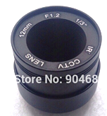
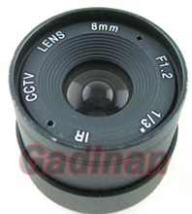
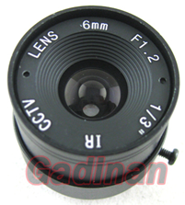
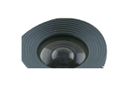
1/3" f/1.2 Fixed Iris IR Lens Set
$8 each 1/3" lenses perform as better than the Pentax 12mm f/1.2
(IR focuses along with visual spectrum)
For Single-CAMS, purchase one set for each camera
For an array, purchase extra lenses of different focal lengths
If you can get some f/0.75 - f/-0.95, you'll get improved results
Be sure to get IR compatible
It's a good idea to use DC auto-iris lenses for cameras facing the sun. Available for under $40
Notes:
These lenses match the performance of the Pentax 12mm f/1.2 lens that has been deployed in over 160 CAMS cameras around the world.

Slide 5
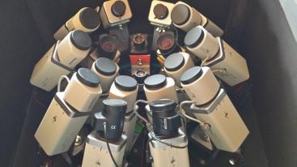
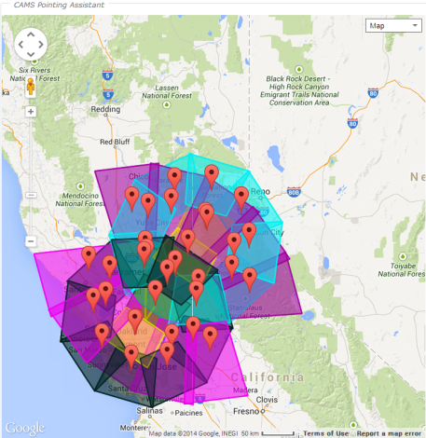
Two 16 Camera Arrays Tuned for Each Other
Near full-sky coverage can be obtained from just two sites for around $4,400 total
QTY | Description | Unit Cost
32 | Cam + Lens | $60
2 | Intel i7 Computers | $700
2 | 8 CH Grabbers | $190
2 | 16 port power supply | $40
2 | Housings | $300
2 | Wiring | $200
Coming soon - Support for dual 8 channel Sensoray grabbers for a total of 16 cameras at once
Notes:
32 x 60 = 1920
2 x 700 = 1400
2 x 190 = 380
2 x 40 = 80
2 x 300
2 x 200
=========
$3780

Slide 6
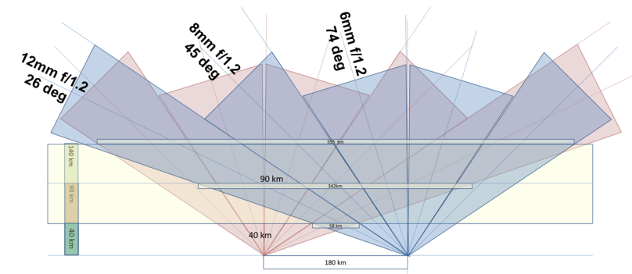
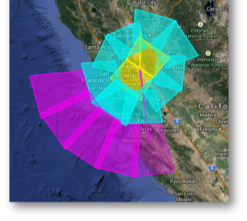
All-Sky Coverage
Tuning the focal length to match the elevation angle, two 16 camera stations can achieve full sky coverage from 18 degrees to 90 degrees
Using a 16 camera box, a considerable area of coverage can be achieved

Slide 7
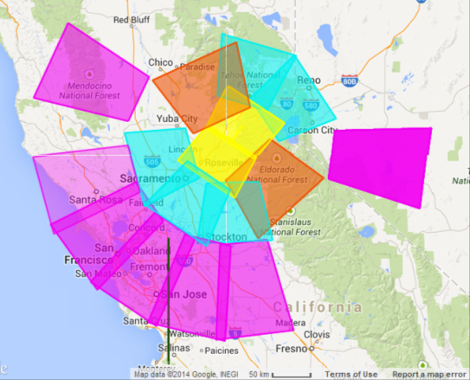
Area of Coverage
There is nothing that says that a 16 camera array must provide contiguous complete all-sky coverage with no gaps - as long as there is another camera paired to overlap the area
Gaps can be covered by single-CAMS stations
The lower the angle of view, the larger the area of coverage

Slide 8
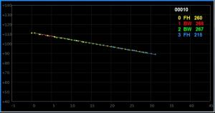
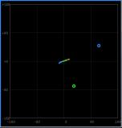
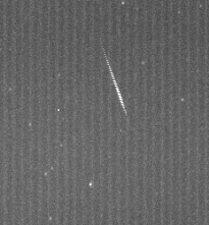
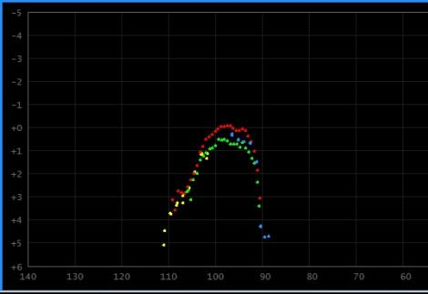
Limiting Magnitude
Height vs Downrange
Lat/Lon
MaxPixel thumbnail of same meteor
Meteor Magnitude vs Height
Excerpt from auto-cal showing Stellar Limiting Magnitude
Mean O-C = 0.595 +- 0.282 arcmin
Star V B-V R IR O-C arcmin
---- ----- ------ ------ ------ ----------
52 6.87 0.44 6.60 6.34 1.018
53 7.15 1.10 6.51 5.91 0.871
54 7.17 1.01 6.58 6.02 0.882
55 7.22 1.04 6.62 6.04 1.159
56 7.16 0.57 6.82 6.49 0.644
57 7.22 0.17 7.10 6.98 0.922
58 7.41 0.54 7.09 6.77 0.671
59 7.63 0.60 7.27 6.93 0.796
60 7.78 0.90 7.26 6.75 0.778
61 7.84 0.10 7.76 7.68 0.614
Mag +5.29 with 100H
Notes:
2014_08_14 085613 mag +5.29

Slide 9
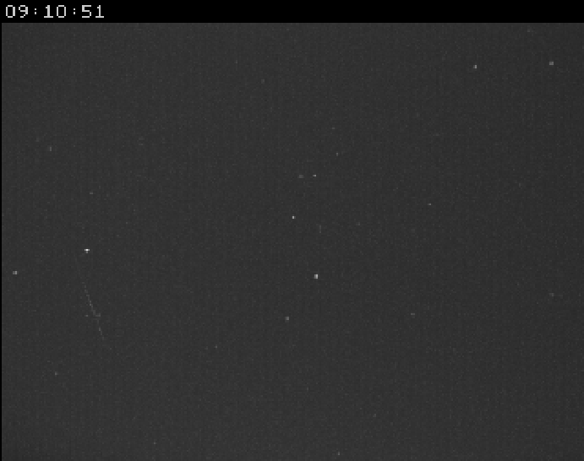
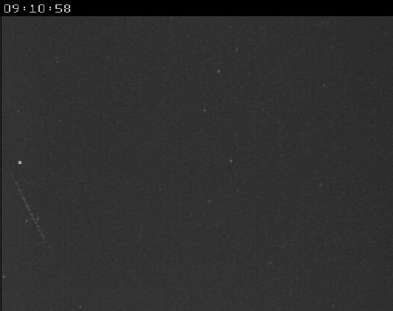
100H vs Watec
Same meteor, same lens, different cameras
The Watec represents the standard
Watec 902H2 Ultimate 8mm f/1.2
PSCB-100H 960H 8mm f/1.2

Slide 10
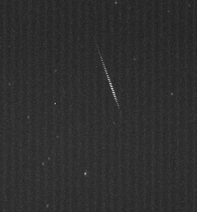
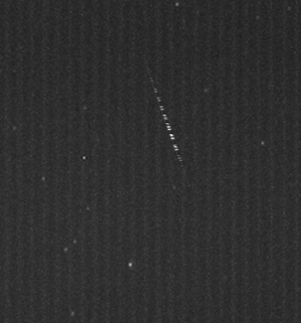
Frame Rate (Strobing)
Care must be taken to adjust the settings to prevent the camera from going into Sens-Up or Night Mode
In these settings, we found that the frame rate dropped to 1/30 or 1/15 sec
It's important to use interlaced capture

Slide 11
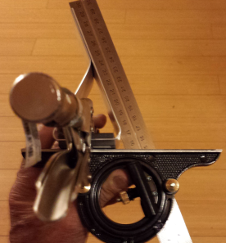
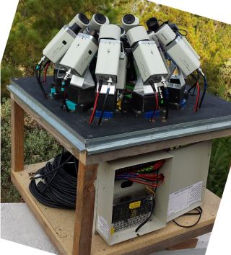
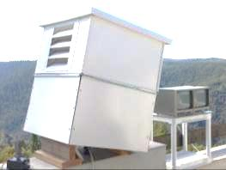
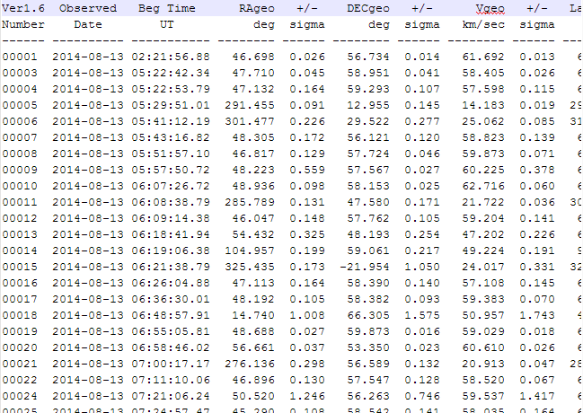
Jim Wray's 18 Camera All-Sky 1/3" Array
Brackets made of flat bar
Inside box showing cameras, brackets, and 16 port power supply
Ventilation maintains internal temp
Some cameras have DC auto-iris and some do not
Over 1,000 orbits contributed by 1/3" cameras from
May 17, 2014 to September 8, 2014
With just 2 cameras!

Slide 12
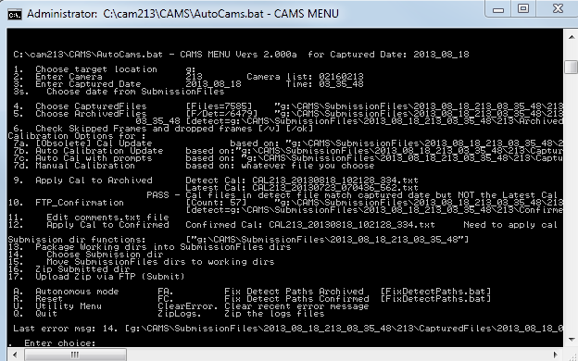
Use AutoCAMS for Autonomous Operation
AutoCAMS is a script-based wrapper around the single-CAMS software
Facilitates the use of the programs and utilities
User-configurable to achieve full autonomous operation for months (until you run out of disk space)
AutoCAMS courtesy of Dave Samuels
Distributed through:
seticams@yahoo.com

