Slide 1
Setting up DWService to access a remote CAMS computer
By Andy Howell and Dave Samuels

Slide 2
ESTABLISH AN ACCOUNT WITH DWSERVICE.net
STEP 1

Slide 3
To sign up for a new DWS account, enter your email address and a password
First, in your browser, navigate to: https://dwservice.net

Slide 4
Iinstall dwagent on the remote computer
STEP 2

Slide 5
From the DWService home page, click “Windows” to download the DWAgent installer

Slide 6
Save the DWAgent installer program anywhere on your computer

Slide 7
Double click the installer to open it. Click the radio button to create a new agent

Slide 8
Enter the DWService credentials you created during Step 1. Enter an appropriate name for the agent (whatever you like).
Note: A good naming convention for DWService agents as follows: CAMS-<site name>-<camera list> Where: <site name> is something like CAMS-FL, CAMS-SA
<camera number> is the first camera number for each board. Examples: CAMS-ForestHill-250,258 CAMS-Lick-549,557,565

Slide 9
To complete the installation process, choose “Install”

Slide 10
Adding the first agent for your computer
Step 3

Slide 11
Configuring the “first” Agent
First, click the Agents tab
Click the “+” to add a new agent representing your computer
Add an Agent for your computer so that you can create shares, which will allow others to connect.

Slide 12
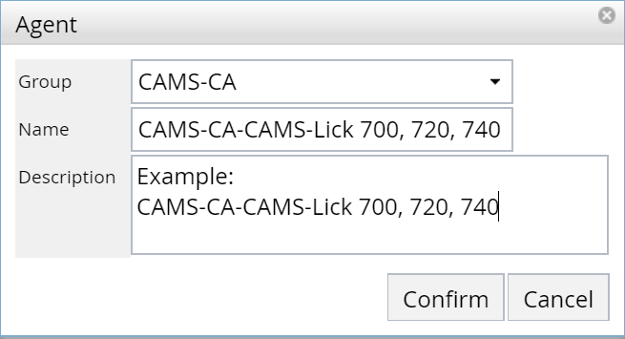
New Agent Dialog
Naming convention: CAMS-<group>-CAMS-<site> <list of first camera numbers for each board>
Note: A good naming convention will allow local and remote users to manage many computers, agents, and shares with the minimum amount of confusion. Remember to choose names that make sense to the user who will be connecting.

Slide 13
Agent “Install code”
Write down the Install Code (include dashes)

Slide 14
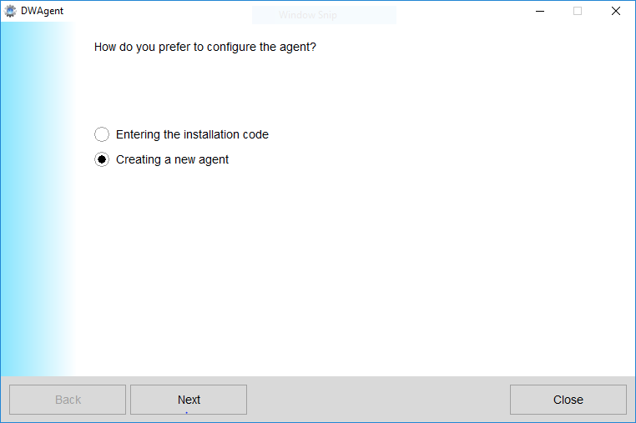
Install DWAgent via Installation Code
Click Next

Slide 15
Install Code
Enter Install Code
Click Finish
In the Agents tab, click the Refresh icon
In the Dashboard tab, click the Refresh icon

Slide 16
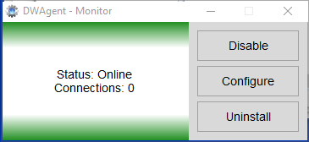
DWAgent desktop app
Run the DWAgent desktop app
Click Configure
Select: Configure agent
Click Next
Click Next

Slide 17
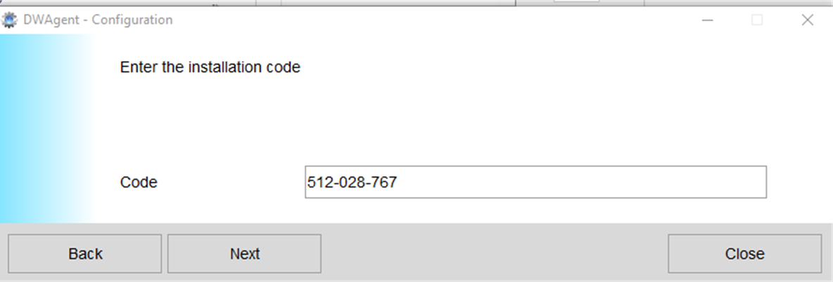
Enter the Installation Code
For Code, enter the Install Code that you wrote down
Click Next

Slide 18
Dashboard
In the Dashboard, click the Refresh icon
The Agent should be visible with “Available”

Slide 19
Create a “Share” for remote access
Step 3

Slide 20
Log in to DWService.net using your credentials.
Click the green +” plus icon to add a new share.
Note: In order to be able to create a persistent share that a user can connect to, that user must have an email address registered with dwservice.
You can send a temporary “link” to non-registered users, but those links will not work after rebooting, or restarting DWService, or making changes to any of the DWService configurations

Slide 21
Assign a name that is meaningful to person you are creating a share for (ask them remote user what share name they prefer or use a naming convention) Optionally, include a description.
Naming convention for shares: CAMS-<network name>/CAMS-<camera list>-<site name>-<user> Example: CAMS-SA/CAMS-6000,6020-Bredel-Dave Samuels
Enter the email used to register for DWService
Check the box for Full access

Slide 22
In the check box, click “Always”
Check the box to allow the share to be used 24/7.

Slide 23
Unnecessary unless you want to create and manage a special password for this share
pjenniskens@seti.org yourself@yourdomain
Add the email used by the remote user that “they” used for registering with DWService. Note: While it is possible to add multiple users here, it is probably best to add yourself to a share so you can test if Shares are working. It is also a good practice to add a separate share for each remote user, especially for: mogulskier@hotmail.com pjenniskens@seti.org
Check this box to allow a temporary direct link to be sent to non-registered users.
It’s a good practice to add a share for yourself.

Slide 24
After clicking “Accept”, DWService will display and Assigned link. This link is temporary, since it changes often. For example, if you change anything about the share, such as modifying the description, the link will change. Therefore, ignore this for now and click Close.

Slide 25
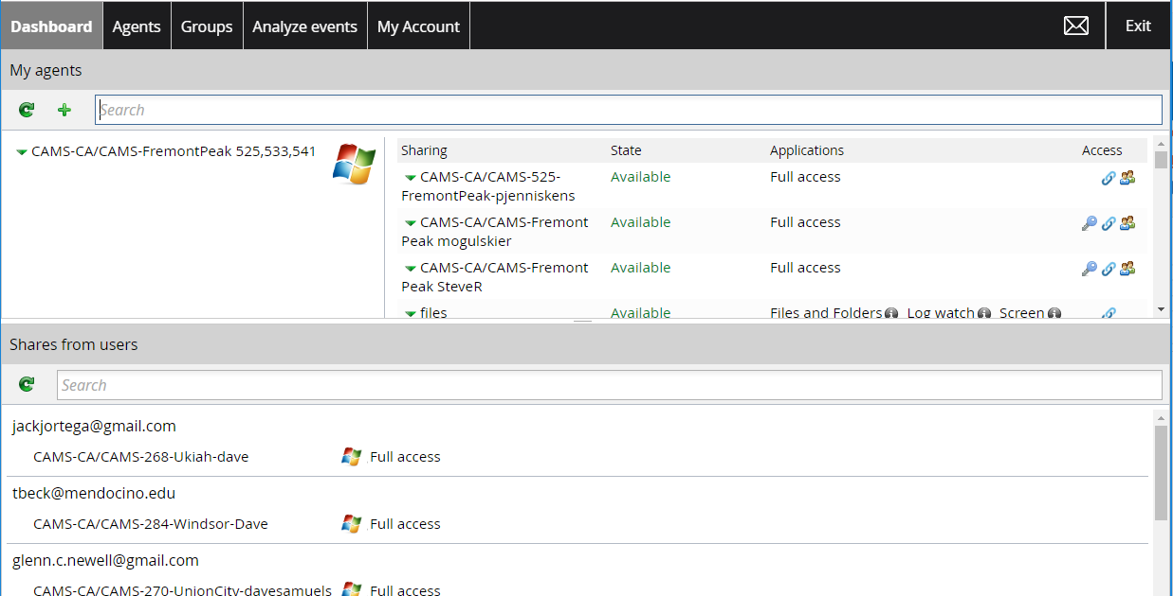
Shows the email address of all the users in this share
Temporary Direct Link icon. You can share this link in an email.
Key icon appears if you are managing special credentials
Click Refresh after shares are changed
Shares Pane
Your share will appear in the remote user’s share pane

Slide 26
Analyze Events tab

Slide 27
DWAgent Monitor
Open the Notification Area box
DWService Agent icon

Slide 28
Number of current connections

Slide 29
Fully Removing DWService in order to reinstall
If you need to reinstall DWService, you need to first fully remove it.
https://speedutilities.com/remove/dwservice.exe.html
Create a Restore point for Windows.
Launch Control Panel
Select Programs and Features
Locate DWAgent
Right-click and select Uninstall.
You might need to remove instances of dwservice and dwagent from the registry.

